Slide 1



Promo Code Redemption User Guide

Slide 2

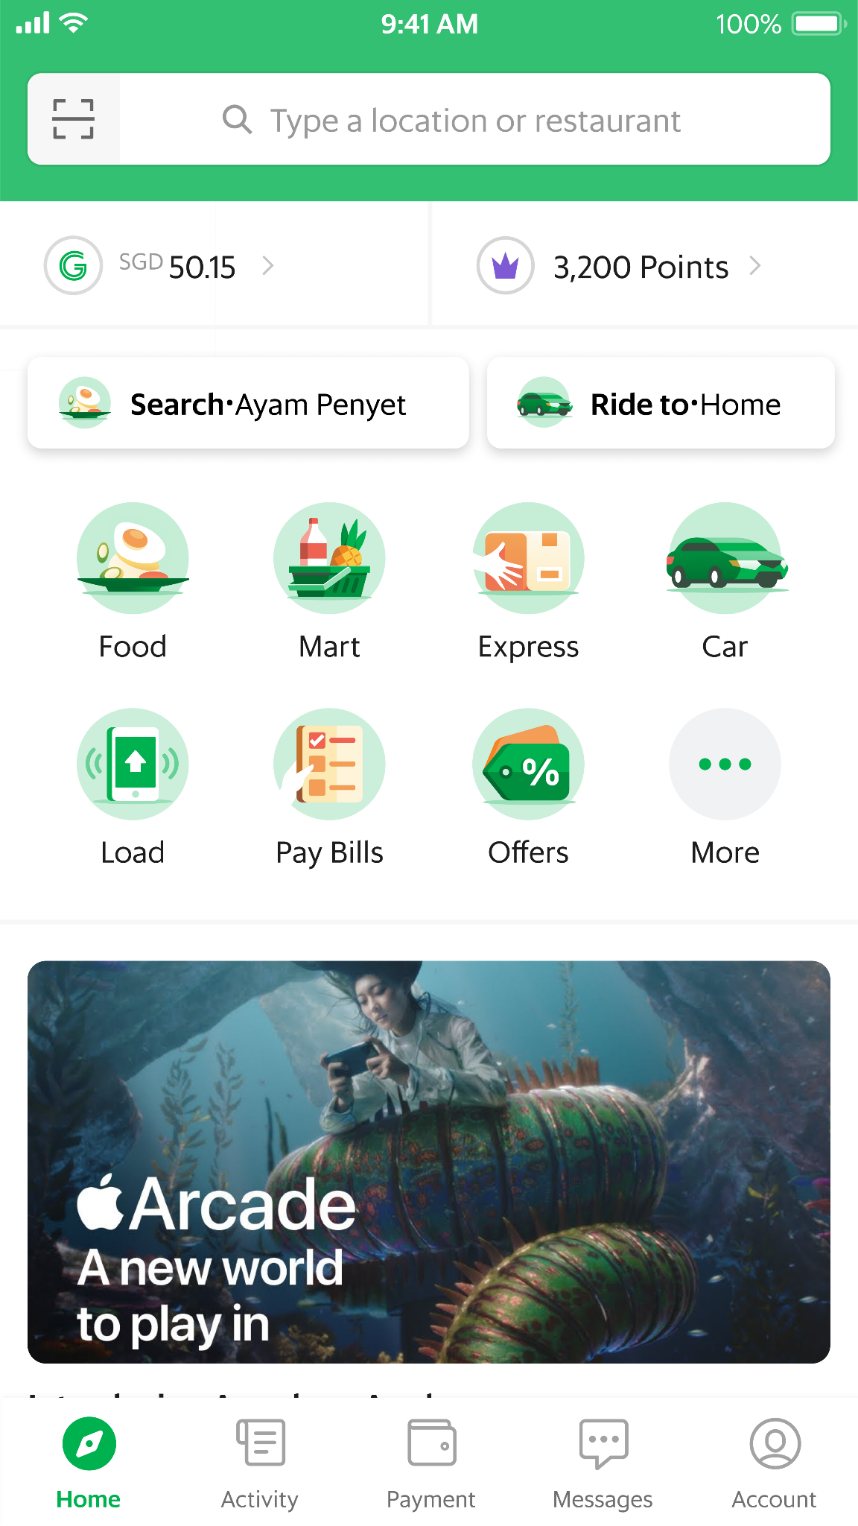
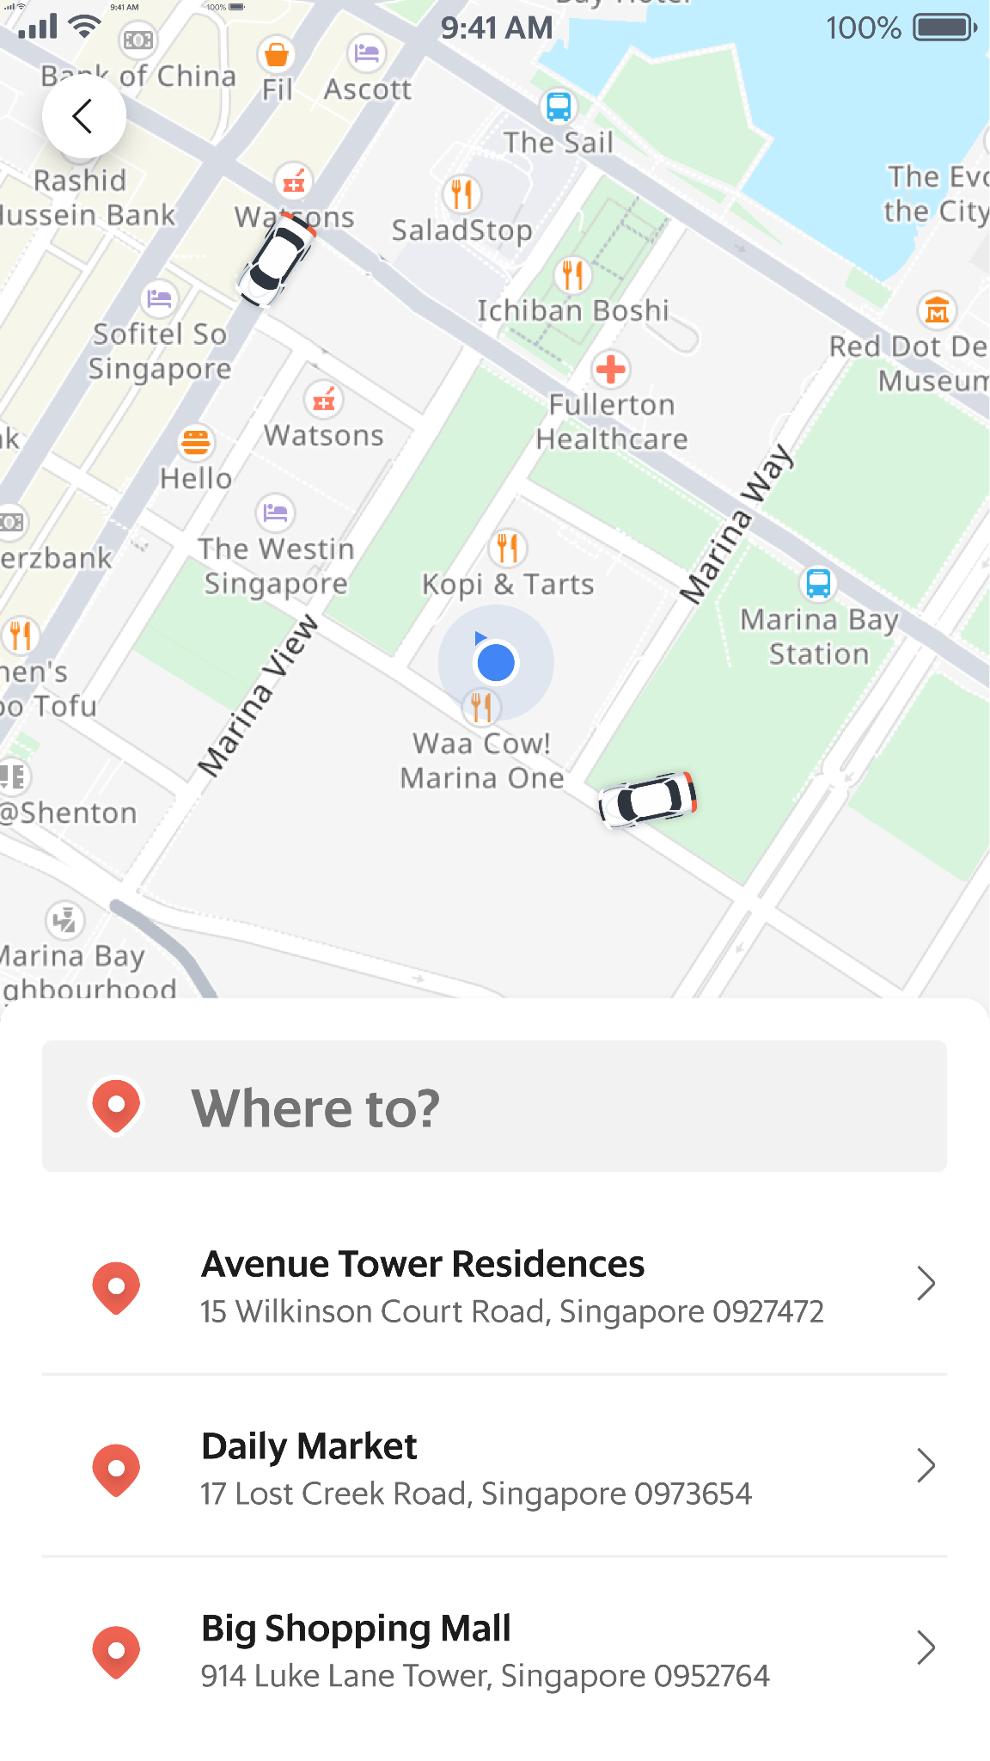
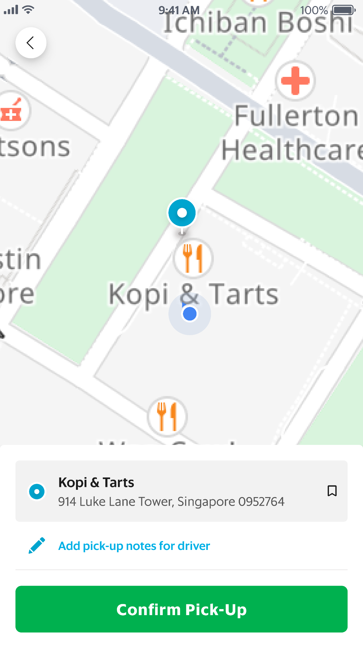

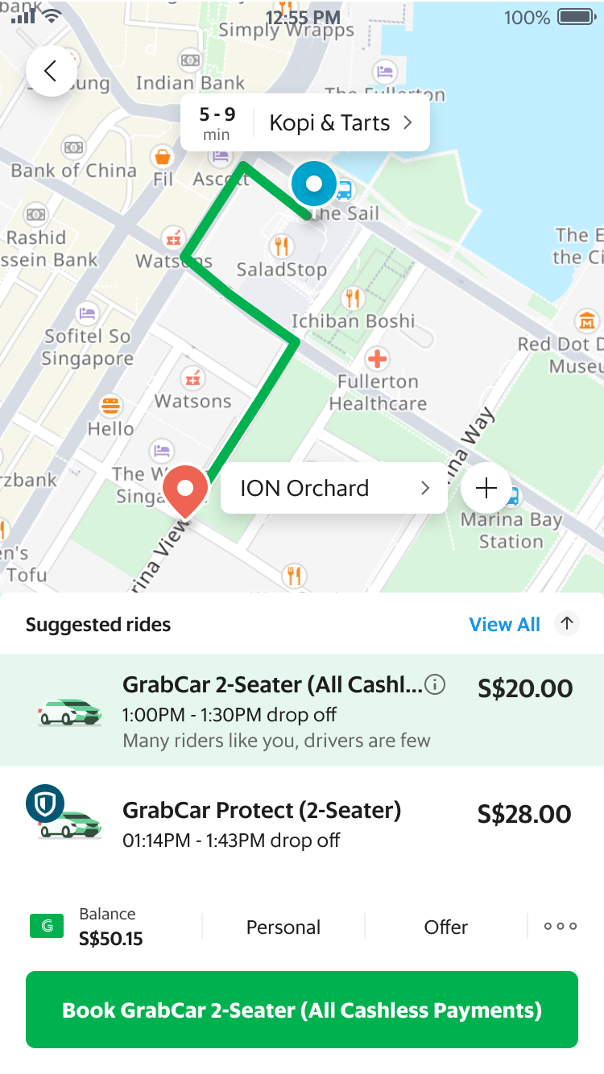
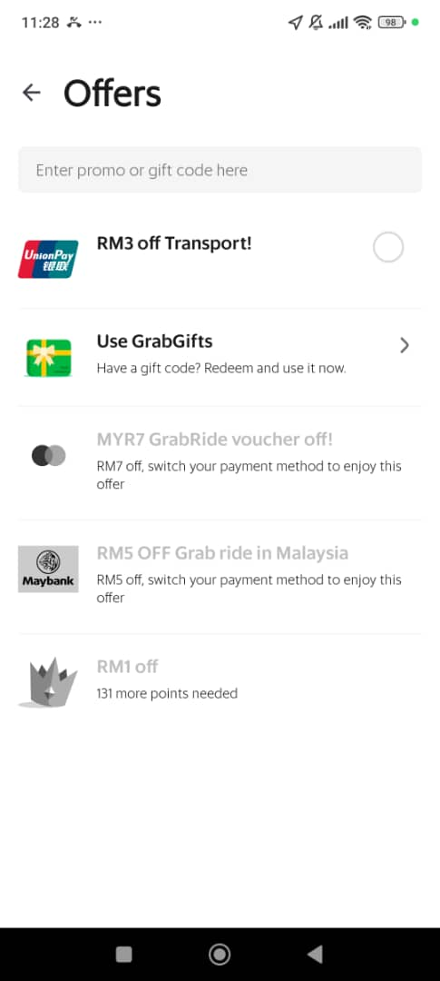
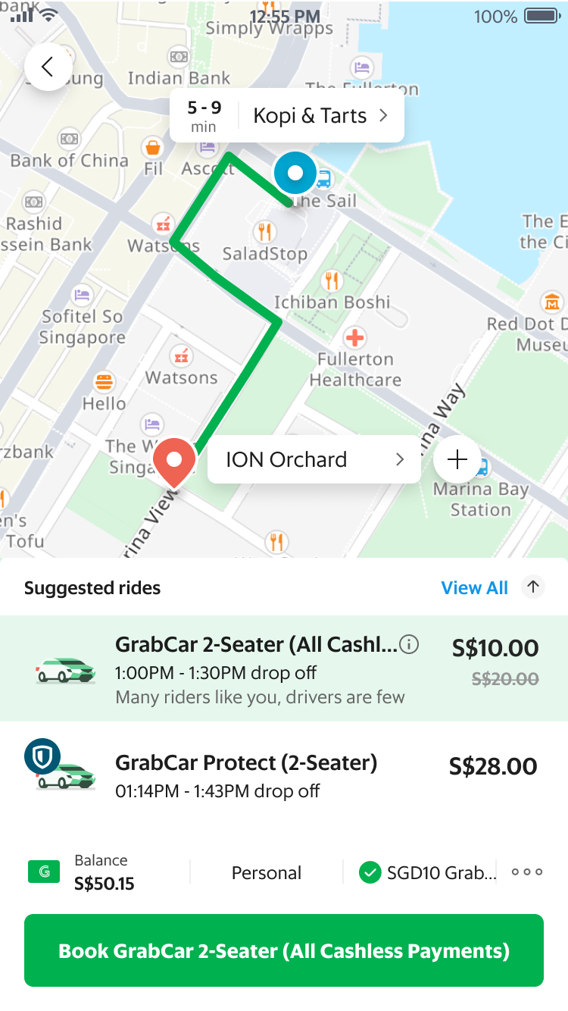
Step 1: Discovery
>
Step 2: Booking
>
Tap ‘Transport’ on the home screen to begin
Enter a pick up and drop off location, then tap ‘Confirm Pick-Up’
Step 3: Redemption
Tap ‘Offer’
Select the UnionPay Discount
Review your booking details
Tap ‘Book’ and your GrabCar will arrive shortly!

